Slide 1
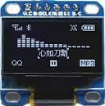
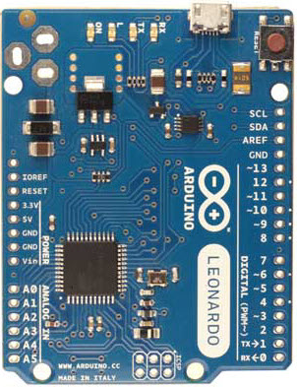

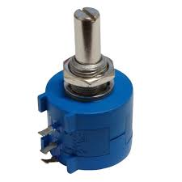

USB PC (HID Descriptor)
CLK
MOSI
CS
D/C
3V3
GND
3V3
CLK
3V3
MOSI
5V
CS
GND
JOYSTICK PSP 1 & 2
D/C
MANAGEMENT DISPLAY
Analog PAD1 X
Analog PAD1 Y
Analog PAD2 X
Analog PAD2 Y
Analog Throttle Left
Analog Throttle Right
THROTTLE
LEFT & RIGHT
BUTTON MATRIX BUS
Group2
Group4
Row6
Group6
Group1
Row8
Group3
Row1
Group5
Row3
Row7
Row4
Row8
Row2
Row5
Row6
Row2
Row7
Row1
Row3
Row5
Group1
Row4
48 BUTTONS
(mixe commutators
& interruptors)
Group2
Group3
Group4
Group5
Group6

